Slide 1
Synaptic Model

Slide 2
Testing the synaptic parameters
Parameter test

Slide 3
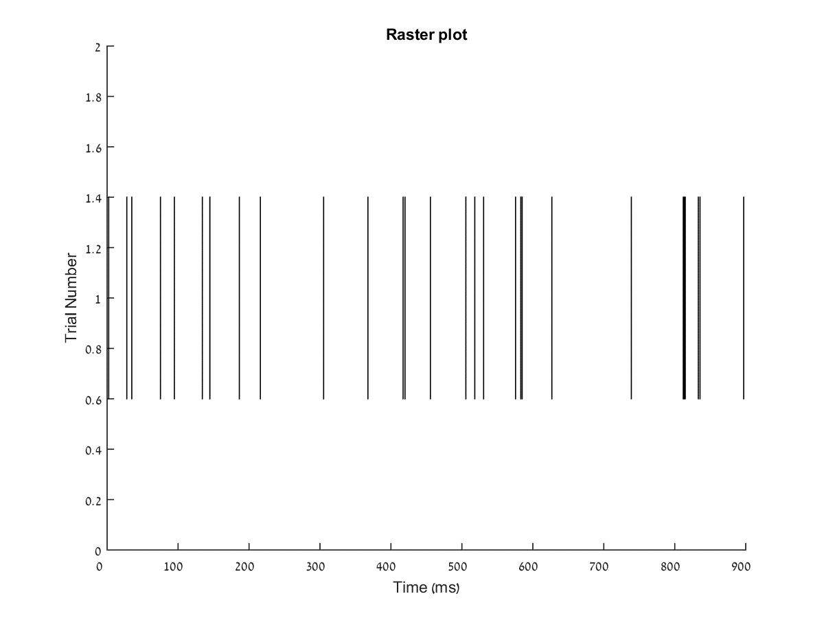
Pre synaptic raster plot
Pre synaptic raster plot
In order to test the activity of the network, the pre-synaptic spikes were set to a rate of 25Hz.

Slide 4
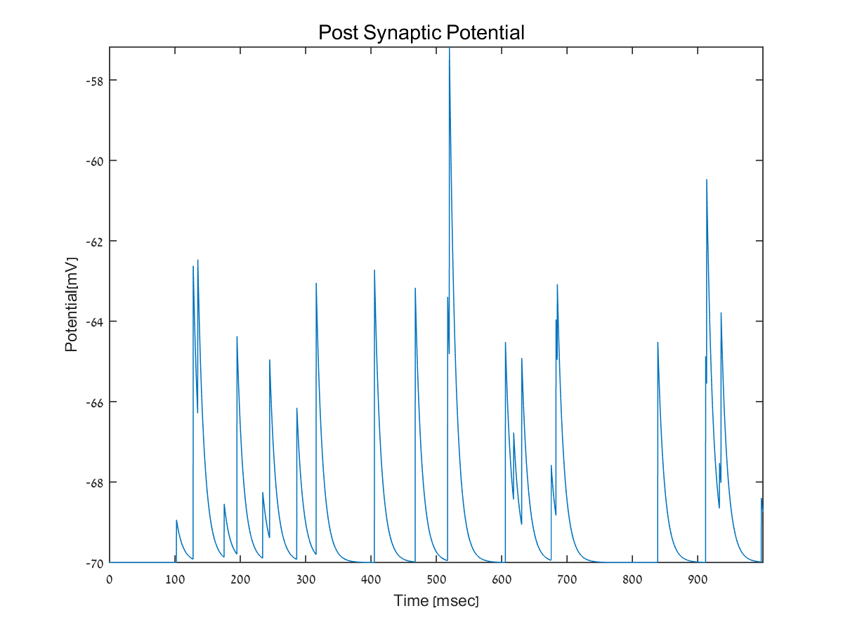
Post synaptic response
Post synaptic current as a function of time
The post synaptic potential was drawn as a function of time for a single neuron connected to a neuron firing at high frequency of 25Hz.
It is possible to notice that with this firing rate and size of EPSC, no neuron reached the threshold required for an AP.
This plot was drawn using the “strong facilitation” parameters.
The whole simulation time is 1sec.

Slide 5
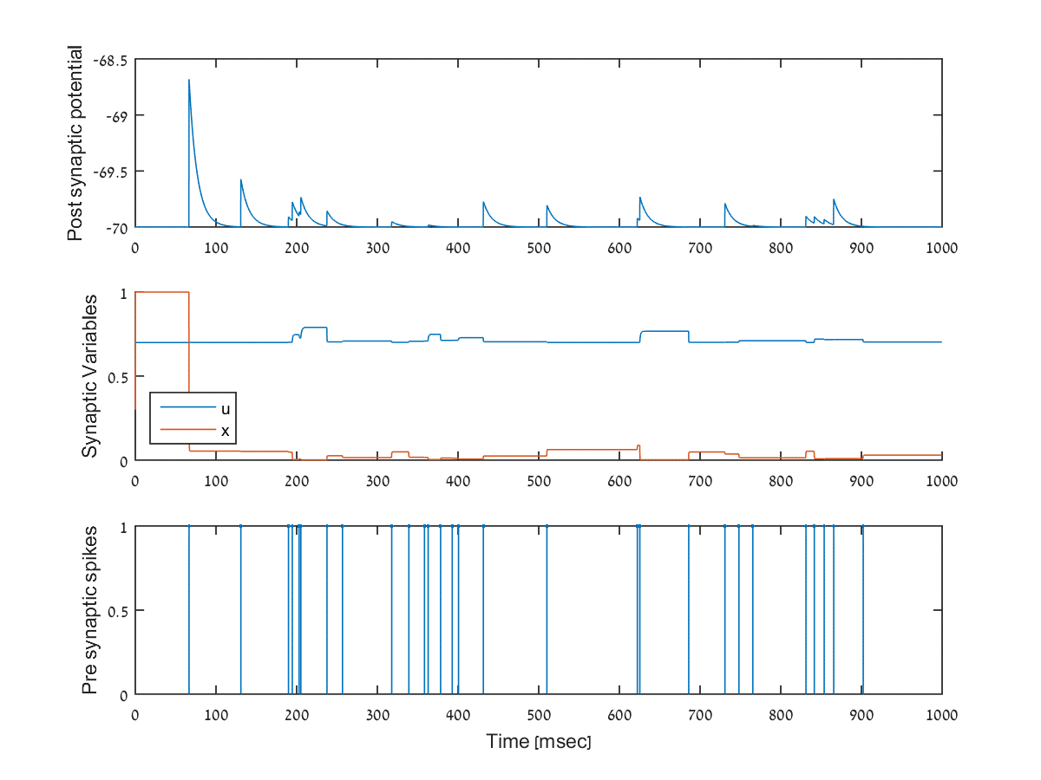
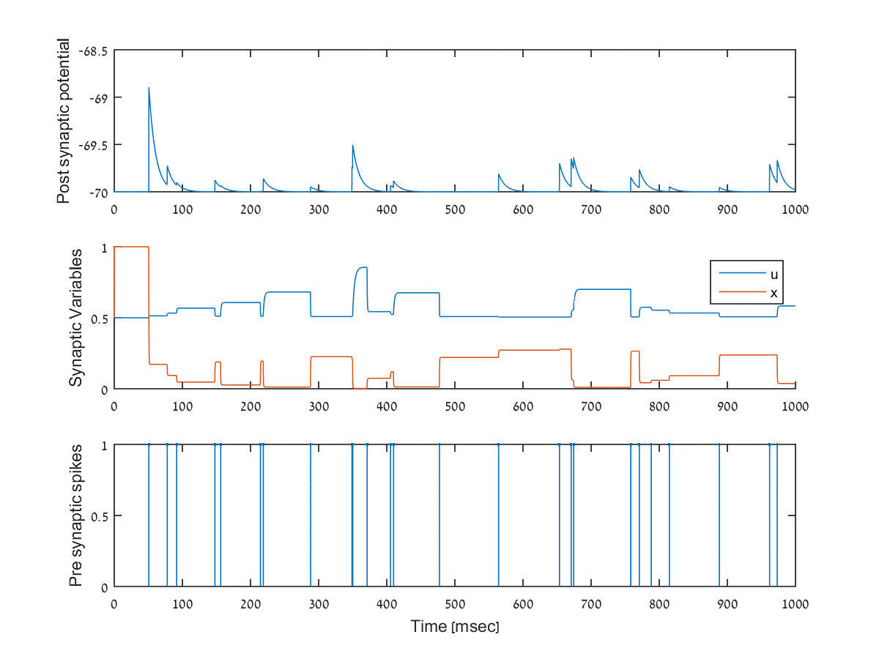
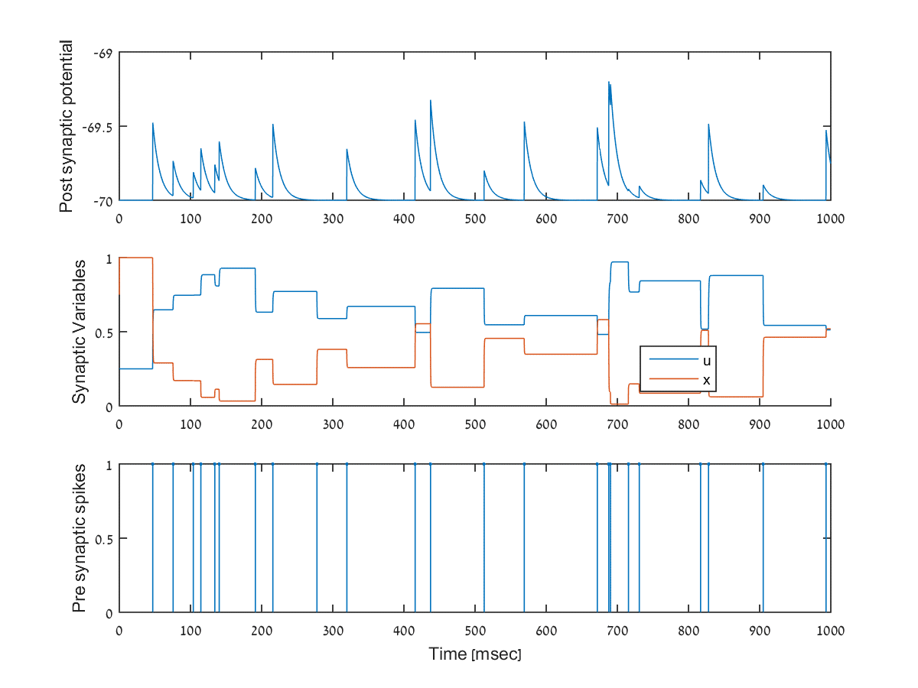
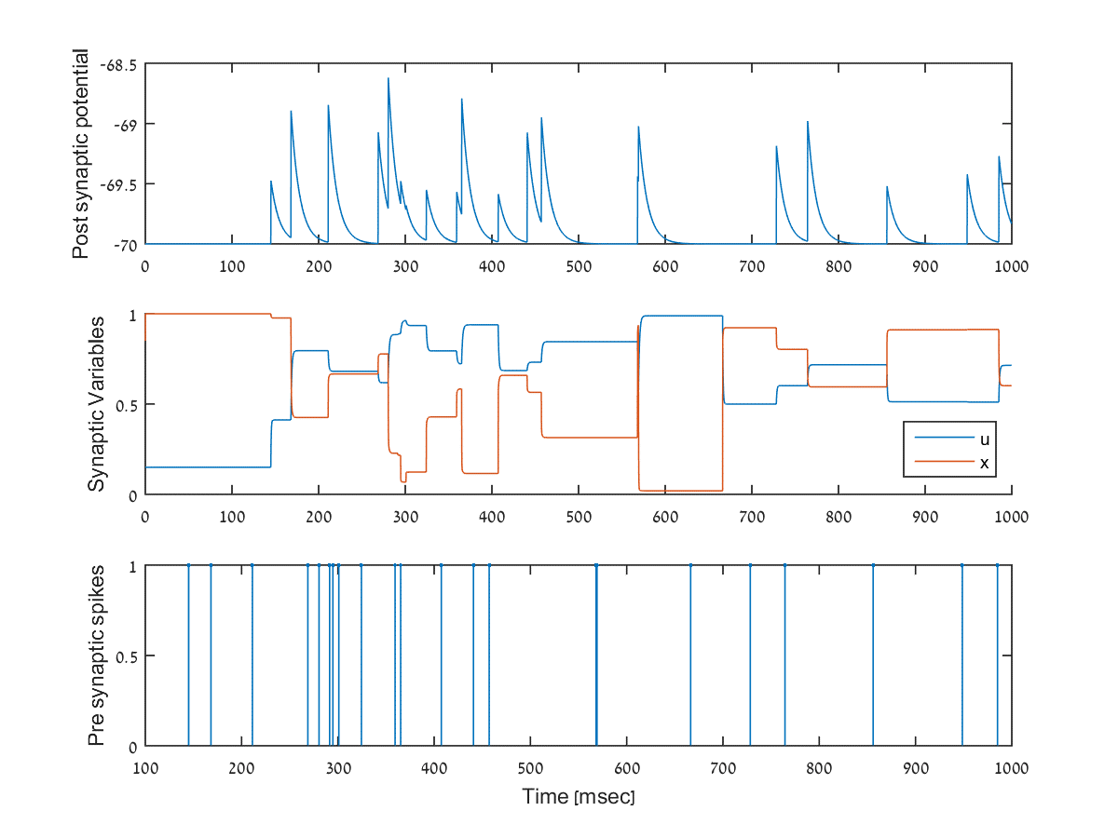
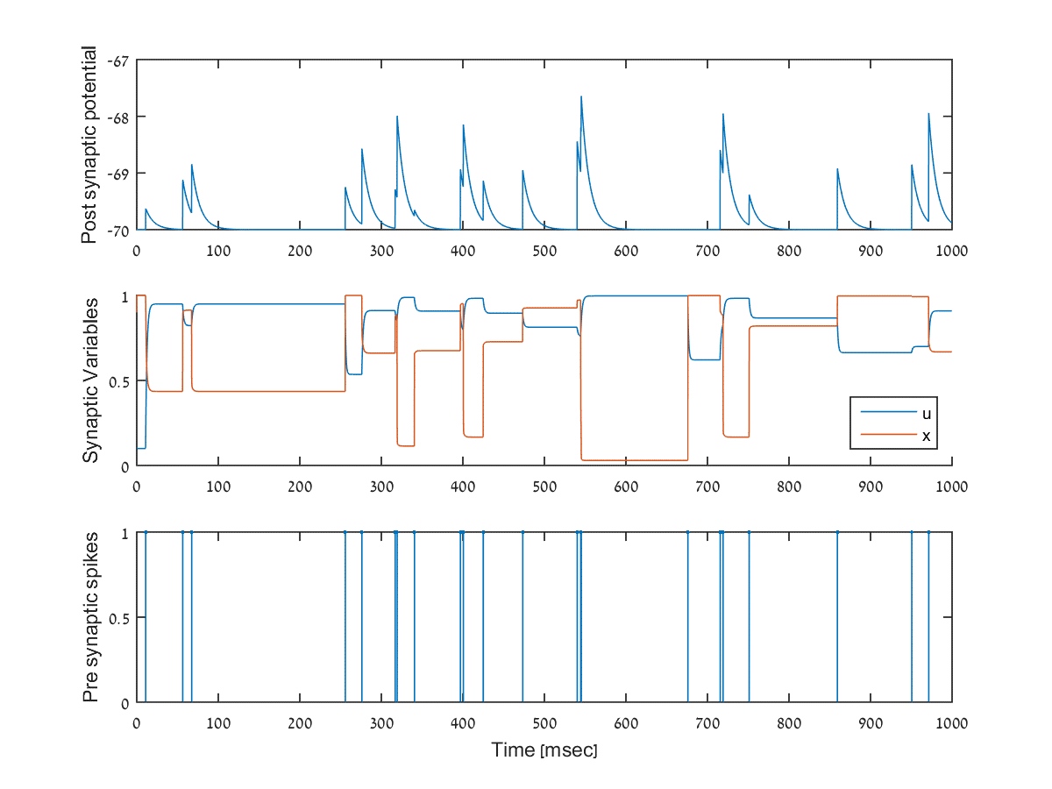
Synaptic parameters, pre and post synaptic potential

Slide 6
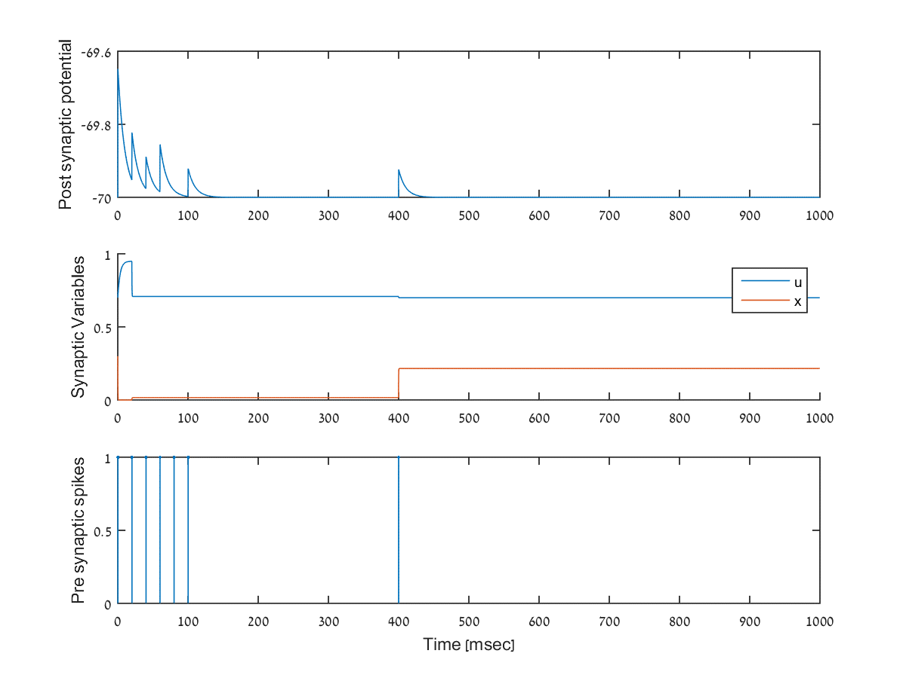
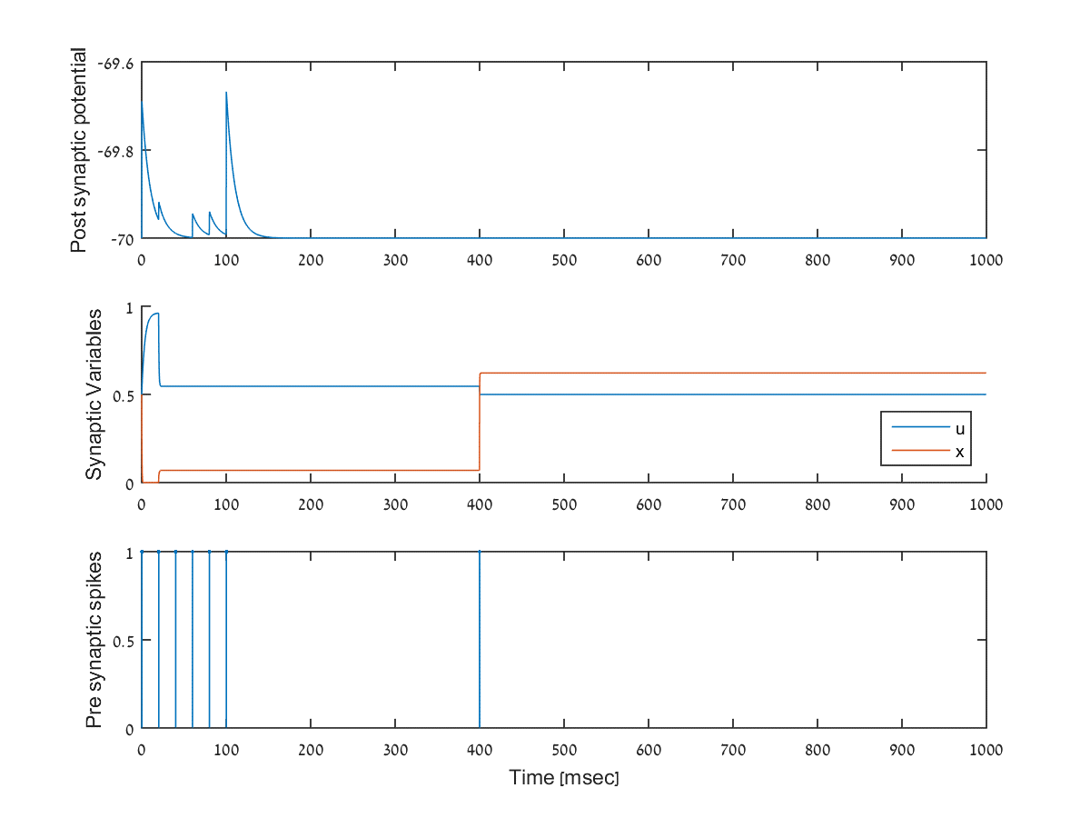
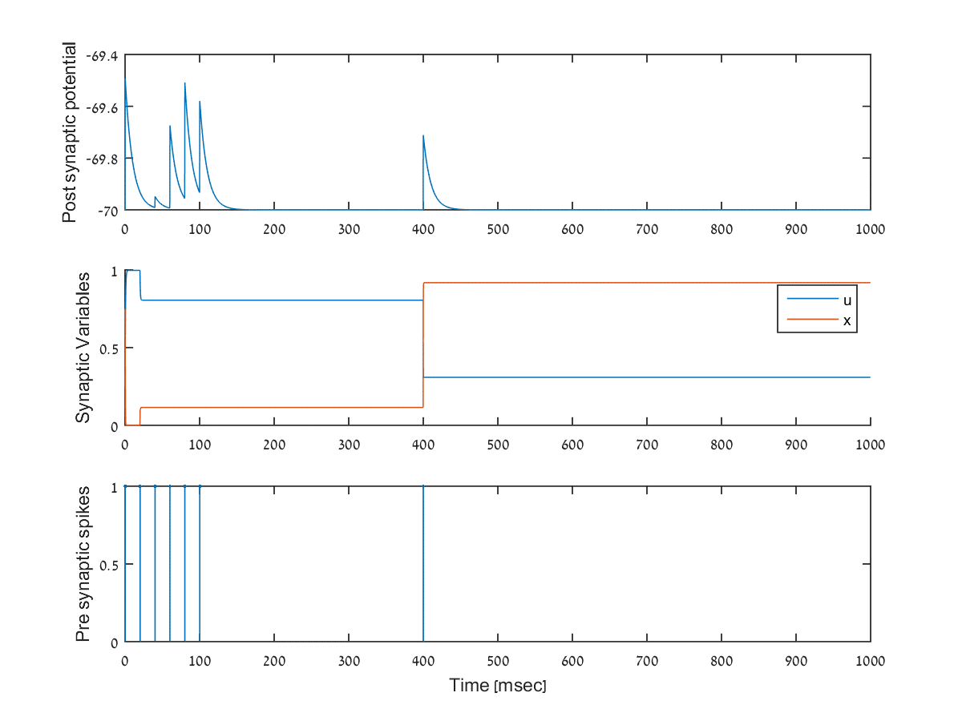
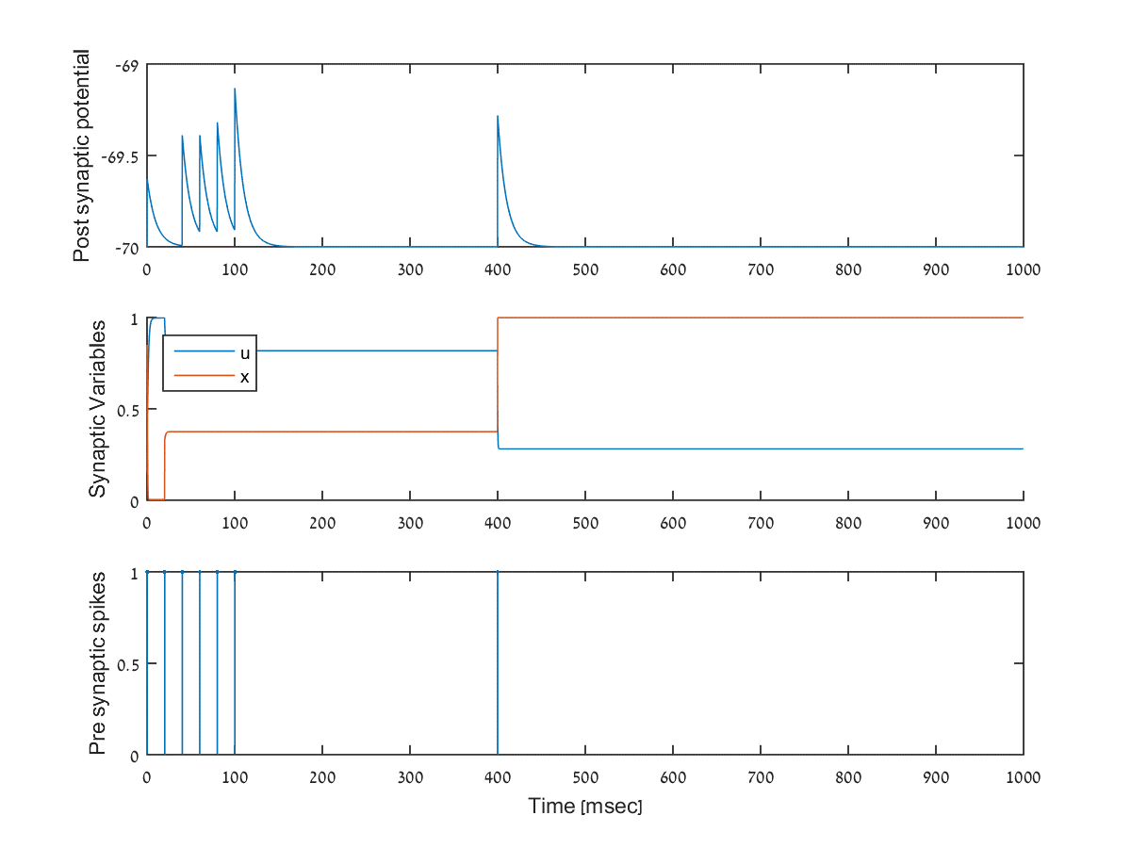
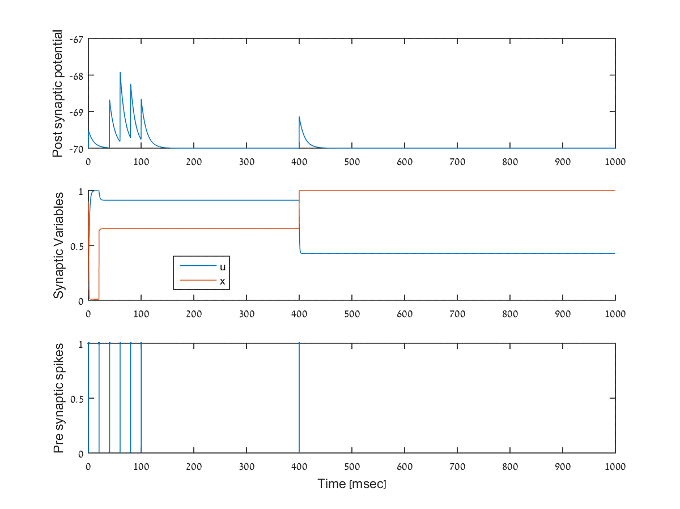
Synaptic parameters, pre and post synaptic potential

Slide 7
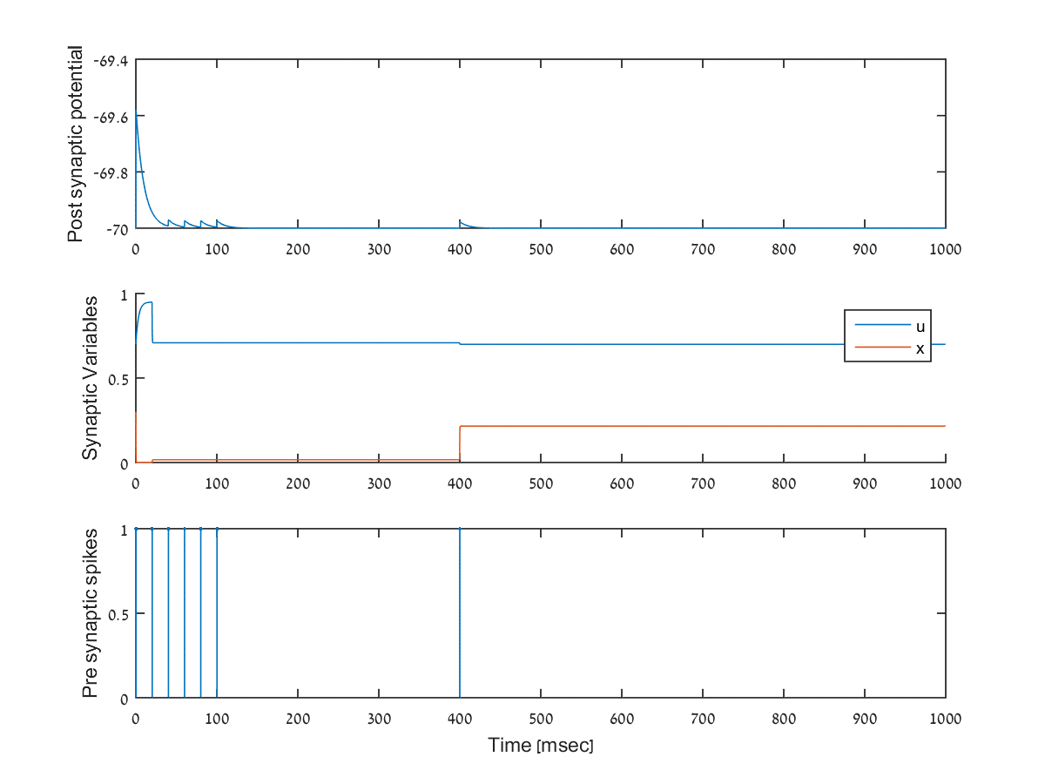
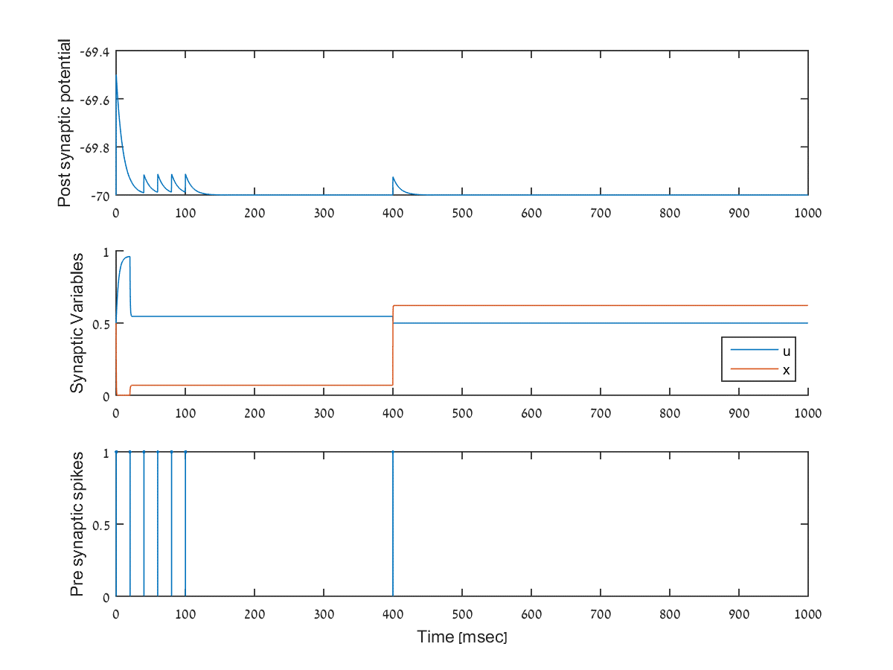
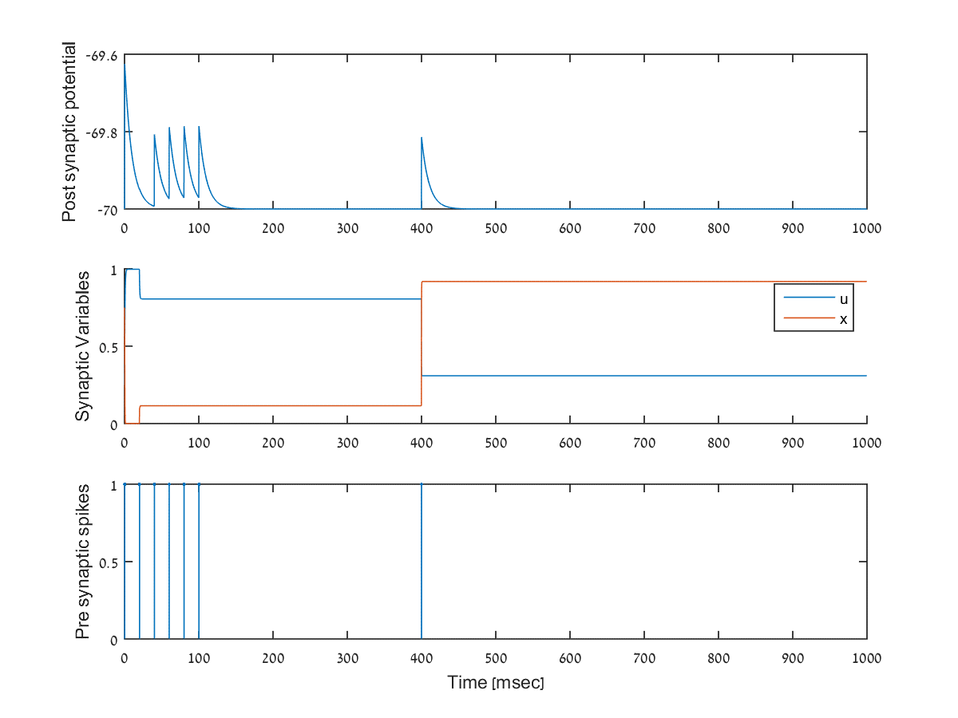

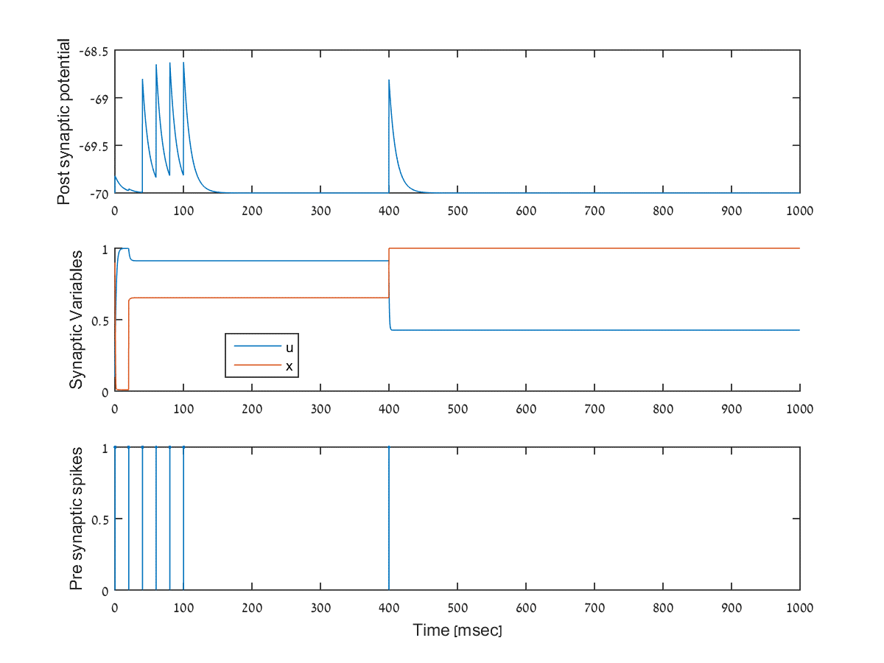

Slide 8
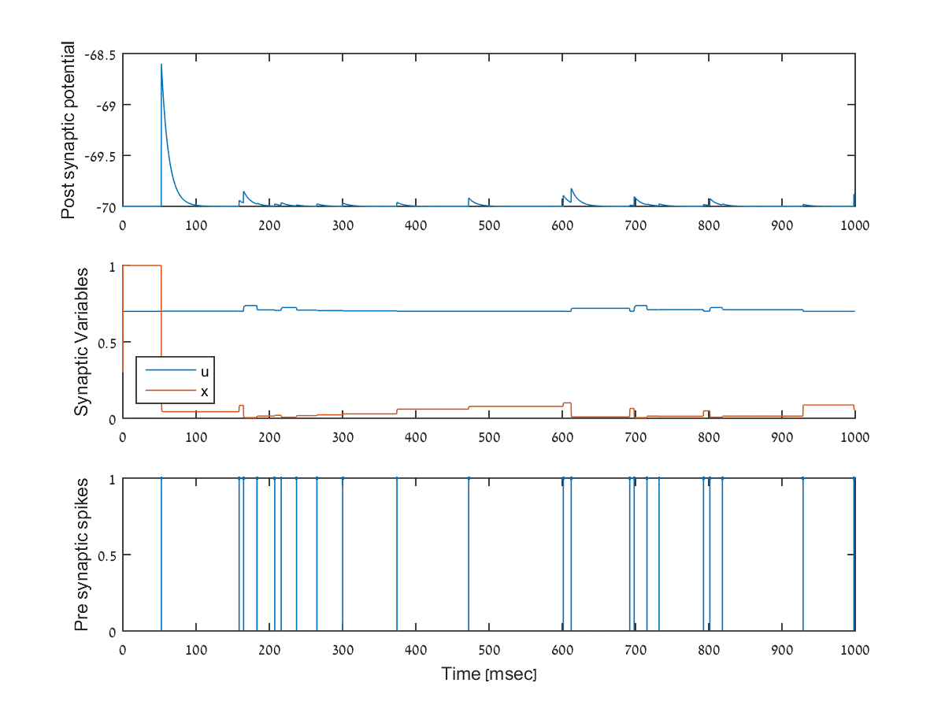
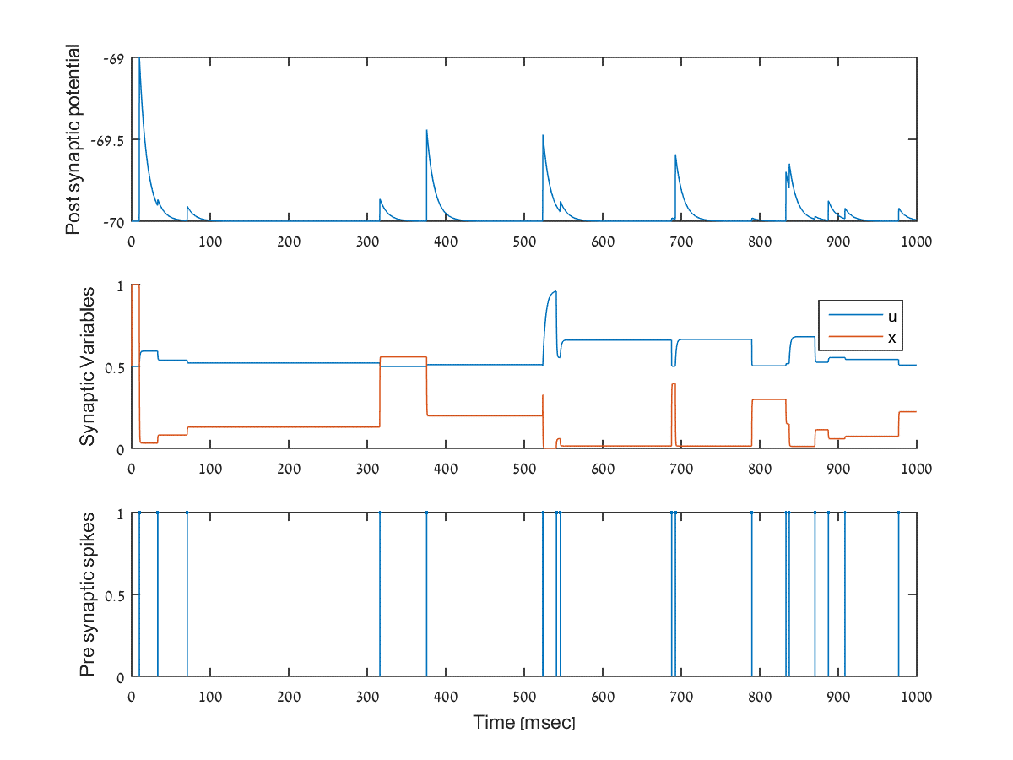
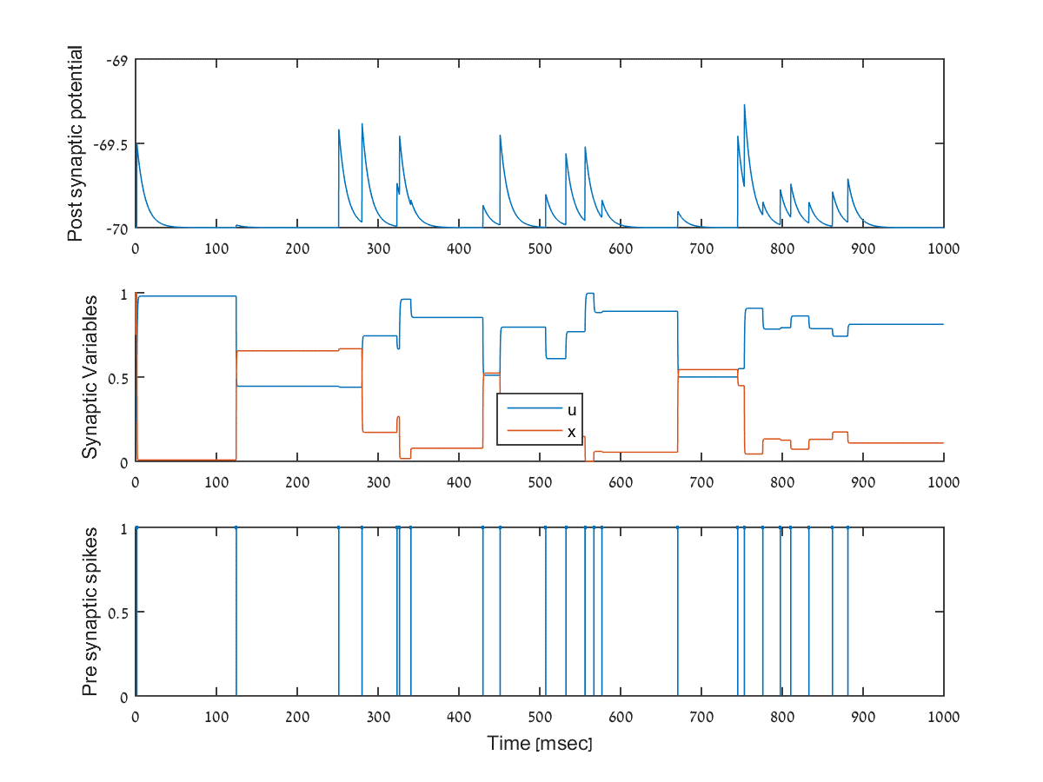
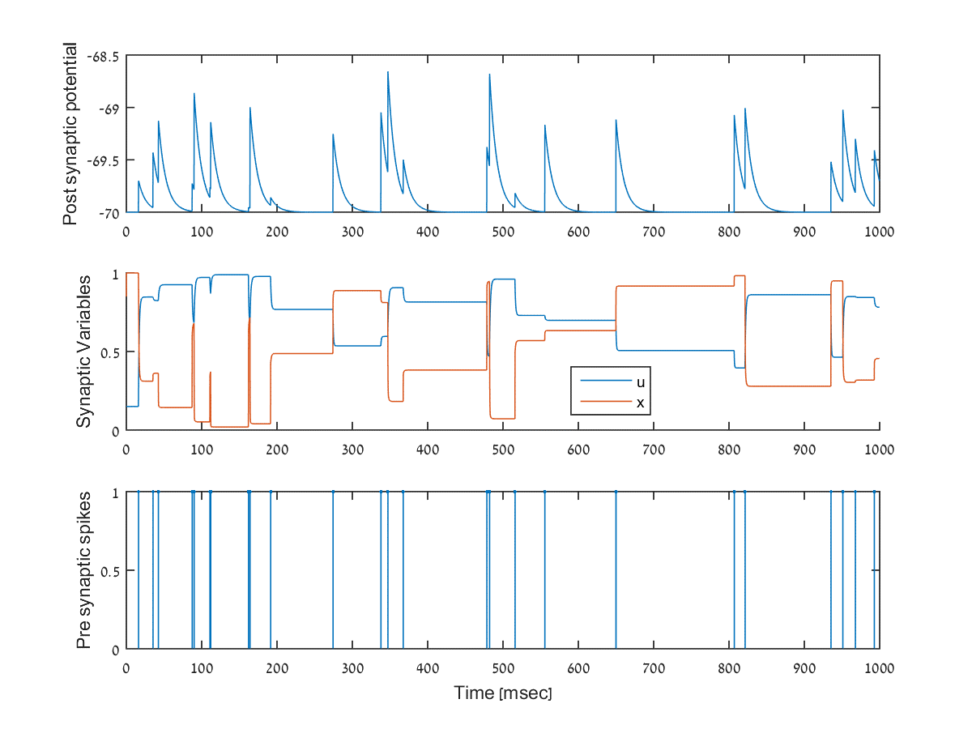
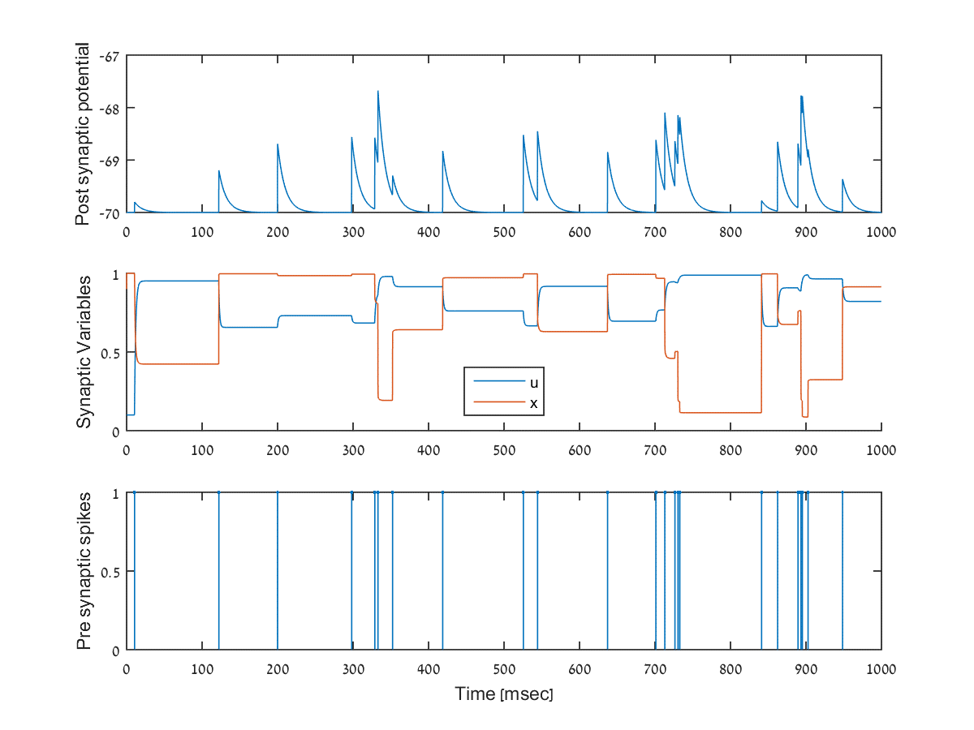

Slide 9
Simulation 1
Associational commissural connections

Slide 10
Pre-synaptic raster plot
In order to simulate the behavior of the CA1-CA3 synapse, the firing rate of the CA1 neurons was set to 20Hz.
Each black dot represents a presynaptic spike.
All EPSPs cased by a presynaptic spikes are of the same size.

